Slide 1
Design and Implementation of Anti-collision Algorithms for RFID Systems
Hazem Elsaid
Doktorandenforum, 19-20.03.2015

Slide 2
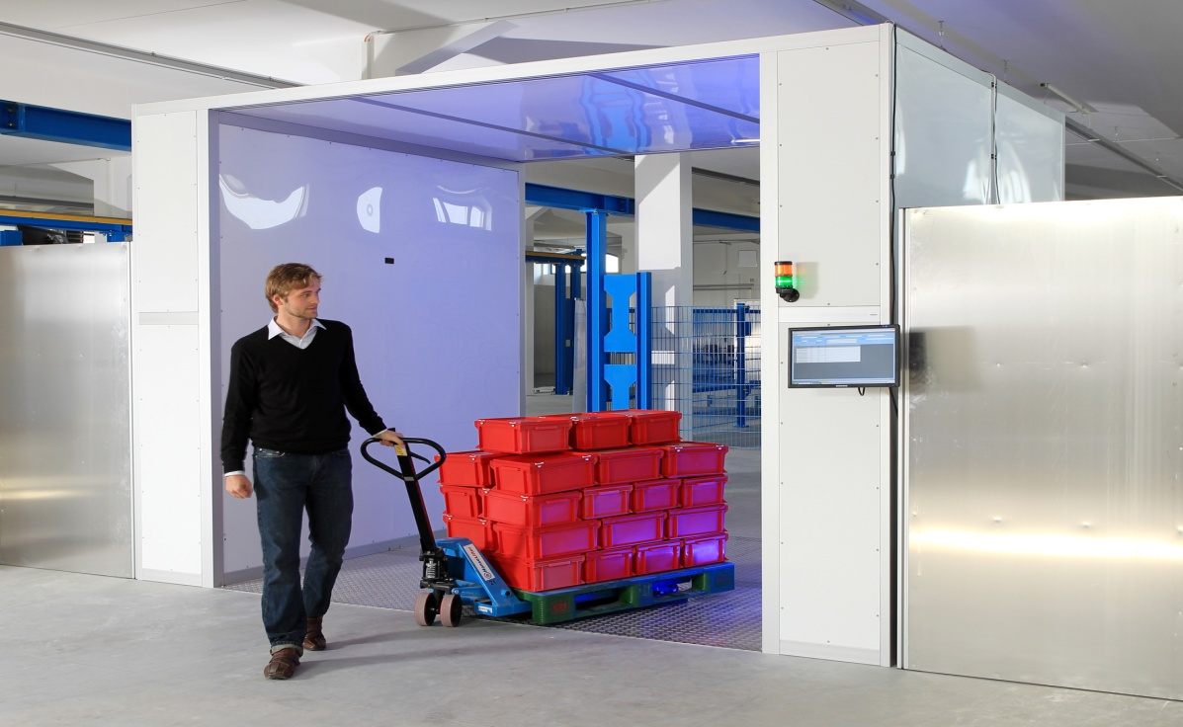

Motivation
System Model:
Single RFID Reader.
Dense RFID network with unknown
number of passive tags.
Tags should be identified in the
minimum possible time.
Maximizing the reading efficiency.
Taken from http://bin95.com/BarCode_RFID.htm
How can we maximize the reading efficiency?

Slide 3
Motivation
Reading efficiency of conventional system:
where: , ,
Reading efficiency of time aware system:
where:
Reading efficiency of collision recovery aware system:
where: is the collision recovery probability of i collided tags.
S
C
E
S
C
E
E
S
C
E
S
C
E
E
t_{k}
t_{k}
t_{e}
S
C
E
S
C
E
E
S
S
E
S
S
E
E

Slide 4
Motivation
Reading efficiency of time and collision recovery system:
Where:
S
C
E
S
C
E
E
S
S
E
S
S
E
E
MAC
PHY
ΔL
How can we get the optimum frame length?

Slide 5
Agenda
Numerical method for optimum frame length calculation.
The proposed closed form frame length for:
Time aware system.
Time and collision recovery aware system.
Multiple collision recovery coefficients aware system.
Time and Multiple collision recovery coefficients system.
Simulation results and conclusions.
Time plan and future work.
Notes:
presentation consists of 5 parts
based on NW, we‘ll model the interference seen by the base station
I‘ll close with some conlcusions

Slide 6
Numerical Method for Optimum Frame Length Calculation
The optimum frame length:
Multi-dimensional look up table.
L_{opt=}0.52

Slide 7
Numerical Method for Optimum Frame Length Calculation
The optimum frame length:
Multi-dimensional look up table:
Slots durations constant C_{t} :
EPCglobal C1G2 Standards
Divided Ratio: DR | Modulation: M | Pilot Length: X | Slots Duration Constant C_{t}
8 | 1 | 0 | 0.5
 |  | 12 | 0.4
 | 2 | 4 | 0.35
 |  | 16 | 0.3
 | 4 | 4 | 0.25
 |  | 16 | 0.23
 | 8 | 4 | 0.2
 |  | 16 | 0.15
64/3 | 1 | 0 | 0.7
 |  | 12 | 0.6
 | 2 | 4 | 0.5
 |  | 16 | 0.45
 | 4 | 4 | 0.4
 |  | 16 | 0.35
 | 8 | 4 | 0.3
 |  | 16 | 0.25

Slide 8
Numerical Method for Optimum Frame Length Calculation
The optimum frame length:
Multi-dimensional look up table:
Slots durations constant C_{t} :
Collision recovery coefficients α_{i}:
The probability of successful collision recovery (PHY-work).
According to the practical measurements, the SNR for successful slots varies between 4 to 12 dB.

Slide 9
Agenda
Numerical method for optimum frame length calculation.
The proposed closed form frame length for:
Time aware system.
Time and collision recovery aware system.
Multiple collision recovery coefficients aware system.
Time and Multiple collision recovery coefficients aware system.
Simulation results and conclusions.
Time plan and future work.
Notes:
presentation consists of 5 parts
based on NW, we‘ll model the interference seen by the base station
I‘ll close with some conlcusions

Slide 10
Time Aware System
Reading efficiency “α_{i} = 0, 0<C_{t}≤1”:
After substitutions:
By solving this equation:
where,

Slide 11
Time and collision recovery aware system
Reading efficiency “α_{i} = α, 0<C_{t}≤1”:
After substitutions:
where,
By solving this equation:

Slide 12
Multiple Collision Recovery Coefficients Aware System
Reading efficiency “α_{i} = α₂, α₃, α_{4,} C_{t}=1”:
where:
where:
Using Descartes’ rules of sign:
Let µ be the number of variations in the sign.
Let n_{p} be the number of positive real solutions.
n_{p}≤ µ which means that n_{p}=0 or 1.
µ- n_{p} is an even integer. Therefore, n_{p}=1.
96%

Slide 13
Multiple Collision Recovery Coefficients Aware System
The four possible solutions:
.
One positive real and three negative real:
β₁> β₂, β₃> β₄ β₁ or β₃.
S is positive real and q is negative real β₃
One positive real, one negative real, and two complex:
S is positive real, and q is negative real X < Y β₃ or β₄
β₃> β₄ β₃.
where:

Slide 14
Multiple Collision Recovery Coefficients Aware System
The proposed final solution is β₃:

Slide 15
Time and Multiple Collision Recovery Coefficients Aware System
Reading efficiency “α_{i} = α₂, α₃, 0<C_{t}≤1”:
where:
The proposed final solution:

Slide 16
Agenda
Numerical method for optimum frame length calculation.
The proposed closed form frame length for:
Time aware system.
Time and collision recovery aware system.
Multiple collision recovery coefficients aware system.
Time and Multiple collision recovery coefficients system.
Simulation results and conclusions.
Time plan and future work.
Notes:
presentation consists of 5 parts
based on NW, we‘ll model the interference seen by the base station
I‘ll close with some conlcusions

Slide 17
Simulation Results
Mean reduction time for identical PHY environment compared to the conventional case L=n:
Time aware proposal.

Slide 18
Simulation Results
Mean reduction time for identical PHY environment compared to the conventional case L=n:
Time aware proposal.
Time and constant collision recovery proposal.

Slide 19
Simulation Results
Mean reduction time for identical PHY environment compared to the conventional case L=n:
Time aware proposal.
Time and constant collision recovery proposal.
Multiple collision recovery proposal.

Slide 20
Simulation Results
Mean reduction time for identical PHY environment compared to the conventional case L=n:
Time aware proposal.
Time and constant collision recovery proposal.
Multiple collision recovery proposal.
Time and multiple collision recovery proposal.

Slide 21
Conclusions
A closed form solutions are proposed to the FSA optimum frame length for:
Variable slots durations.
Variable slots durations with constant collision recovery probabilities.
Equal slots durations with multiple collision recovery probabilities.
Variable slots durations with multiple collision recovery probabilities.
The closed forms save multidimensional look up tables (storage-time).
The mean reduction in reading time compared to the conventional case (L=n) shows the gain of frame length adaptation (MAC-layer) using the same PHY-layer environment.
The gain of the MAC-layer is added to the gain of the PHY-layer.

Slide 22
Agenda
Numerical method for optimum frame length calculation.
The proposed closed form frame length for:
Time aware system.
Time and collision recovery aware system.
Multiple collision recovery coefficients aware system.
Time and Multiple collision recovery coefficients system.
Simulation results and conclusions.
Time plan and future work.
Notes:
presentation consists of 5 parts
based on NW, we‘ll model the interference seen by the base station
I‘ll close with some conlcusions

Slide 23
Time Plan and Future Work
 | Work Milestone | Period #1 1.04.13 – 01.10.13 | Period #2 1.10.13 – 01.10.14 | Period #3 1.10.14 – 1.04.15 | Period #4 1.4.15 – 01.10.16
WP1 | - Rreview scientific literature and documentation. - Specify a concrete path for my innovation.
WP2 | - Propose a novel tag estimation algorithm and publish it in a conference paper Smart Systech 2014. - Co-operate with Hamed Salah to implement RFID offline receiver on USRP and publish the results in a conference paper Smart Systech 2014. - Analyze the optimum value of FSA frame length taking into consideration the time differences in slot durations and publish the results in a journal paper. “IEEE systems Journal”.
WP3 | - Analyze the optimum value of FSA frame length taking into consideration the time and collision recovery probability. - Find a closed form for FSA frame length taking into consideration the collision recovery probability and the time differences in slot durations.
WP4 | - Publish all pending publications - Finalizing the system implementation on USRP kit. - Submit the overall system in a suitable paper.
WP5 | - Ph.D. Thesis writing. - Ph.D. Examination.
Done
Expected
Conference paper
Journal paper
Patents

Slide 24
Publications and Patents
Published:
Conferences:
Hazem A. Ahmed , Hamed Salah, Joerg Robert, and Albert Heuberger,‘’An Efficient RFID Tag Estimation Method Using Biased Chebyshev Inequality for Dynamic Frame Slotted ALOHA’’ Smart SysTech 2014, Dortmund, Germany.
Hamed Salah, Hazem A. Ahmed , Joerg Robert, and Albert Heuberger, ‘’A Study of Software Defined Radio Receivers for Passive RFID System’’ Smart SysTech 2014, Dortmund, Germany.
Journals:
Hazem A. Ahmed , Hamed Salah, Joerg Robert, and Albert Heuberger,‘’A New Optimization Criterion for Frame Slotted ALOHA in State-of-the-Art RFID Systems’’ IEEE System Journal.

Slide 25
Publications and Patents
Submitted:
Conferences:
Hazem A. Ahmed , Hamed Salah, Joerg Robert, and Albert Heuberger, ‘‘A New Optimization Criteria For Frame Slotted ALOHA Utilizing Time and The Collision Recovery Coefficients’’ Smart SysTech 2015, Achen, Germany.
Hamed Salah, Hazem A. Ahmed, Joerg Robert, and Albert Heuberger, ‘‘FFT Based Rate Estimation for UHF RFID Systems ’’ Smart SysTech 2015, Achen, Germany.
Journals:
Hamed Salah, Hazem A. Ahmed , Joerg Robert, and Albert Heuberger, ‘‘A Closed Form Solution for DFSA Frame Length Utilizing The Time and Capture Aware Reading Efficiency ’’ IEEE Communication Letter.
Patents:
Hazem A. Ahmed, Hamed Salah, Joerg Robert, and Albert Heuberger, Wolfram Strauß ‘‘A New Frame Length Optimization using Collision Recovery Probability for Frame Slotted ALOHA ’’.
Hamed Salah, Hazem A. Ahmed, Joerg Robert, and Albert Heuberger, Wolfram Strauß ‘‘An Efficient Collision Recovery Based on Modified Tag/Reader for Epcglobal Class 1 Gen 2 Standard’’.

Slide 26
Publications and Patents
Planned:
Conferences:
Hazem A. Ahmed, Hamed Salah, Joerg Robert, and Albert Heuberger, ‘‘An Efficient Collision Recovery Based on Modified Tag/Reader for Epcglobal Class 1 Gen 2 Standard’’ IEEE RFID TA 2015, Tokyo, Japan (writing).
Hazem A. Ahmed, Hamed Salah, Joerg Robert, and Albert Heuberger, ‘‘A Closed Form Solution for Frame Slotted ALOHA Utilizing Time and Multiple Collision Recovery Coefficients’’ IEEE Radio Wireless Week (RWW2016), (written).
Hamed Salah, Hazem A. Ahmed , Joerg Robert, and Albert Heuberger, ‘‘Tag collision recovery technique without channel estimation for RFID systems’’ IEEE RFID TA 2015, Tokyo, Japan (writing).
Hamed Salah, Hazem A. Ahmed , Joerg Robert, and Albert Heuberger, ‘‘An Algorithm for Maximum Likelihood decoding for RFID Systems’’ IEEE Radio Wireless Week (RWW2016), (writing).
Journals:
Hazem A. Ahmed , Hamed Salah, Joerg Robert, and Albert Heuberger,‘’ALOHA Frame Length Optimization Using Multiple Collision Recovery Coefficients’’ IEEE System Journal, (80% written)

Slide 27
Challenging Questions!!!
1- What would be the effect of the initial frame length?
2- Is there any other physical factors affect the frame length?

Slide 28

Thanks for your kind attention!
Hazem.a.elsaid@fau.de

